Slide 1
TRIG Capstone Project
25 GHz Radar

Slide 2
Who is TRIG?
TRIG – Transrail Innovation Group
Goals
Digitize rail industry
Improve safety
Increase efficiency

Slide 3
Project Objectives & Scope
Team Objective – Develop a simulation that emulates the current radar system to test for non-idealities.
The system must be able to measure volume and “heel” of commodities such as heavy crude, light crude, and diesel.
The model must be composed of discrete active and passive blocks for better testing.
System would operate at SHF

Slide 4
Benefits to TRIG
Allows for testing of non-ideal radar component behaviour
Helps to determine effect of vapor space, signal reflection, misalignment, and the various commodities in the tank on the signal properties and radar accuracy.
Permits TRIG to test new radar ideas in quick succession, isolate and test individual radar blocks in a cost-effective manner.

Slide 5
Project Management

Slide 6
Progress from December
Switched from Simulink blocks to MATLAB Code
Functions for each section, instead of Simulink blocks
Individual system components have been integrated together
Reasons for change:
Faster to implement
Easy to debug
Have a version control system for code
Easy to add functions
Less learning curve

Slide 7
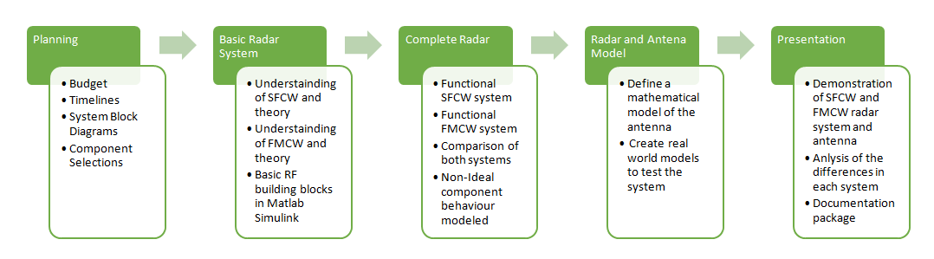
General Timeline
Notes:
This is a very high level timeline of what needs to be done
This general timeline has guided our WBS and GANTT chart
Where are we now?
We are now in the designing of the basic radar system

Slide 8
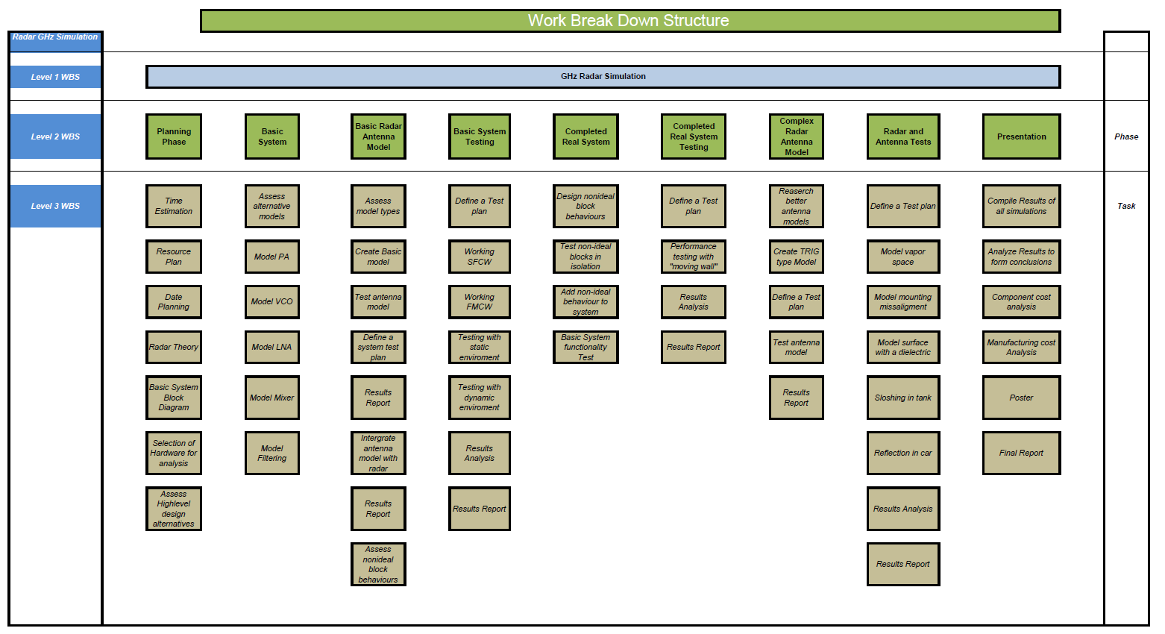
Notes:
In detail we are in the Basic system portion of the WBS.
This was broken down into Planning, Basic system, basic model with antenna, completed real model, completed real system, complex radar testing and presentation
As can be seen from the diagram we have included time to define and create test plants to ensure things are working before we move on the next stage
Essentially we are in an experimental stage of the basic radar as we are learning about the functionality of Simulink and how we will apply its features to our simulation

Slide 10
Progress
Basic System
1-Nov to 25-Dec
Basic System Testing
25-Dec to 25-Jan
Real System Design
25-Jan to 15-Feb
Complex Radar Antenna Model
15-Feb to 18-Mar
Presentation
5-Mar to 20-Mar
Notes:
We are on track and have set a deadline to finish a basic system by the end of december with testing beginning Janurary through the end of janurary

Slide 11
System Design Progress

Slide 12
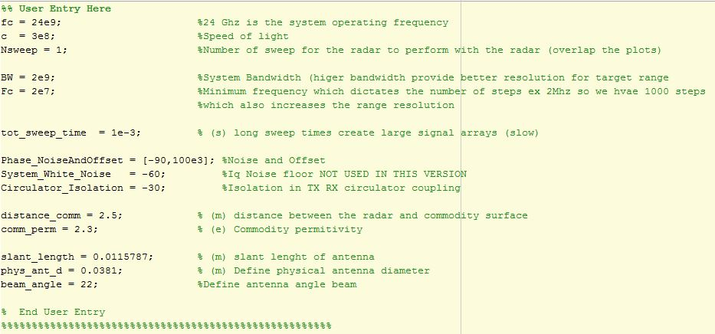
User Entry

Slide 13
Completed Tasks
Antenna defined for TRIG specifications
15 dB gain
Standard circular horn equations
Cylindrical RCS functional
Commodity permittivity defined
Propagation in free space (2 way)

Slide 14
Planned Objectives
Commodity ‘sloshing’
Changing height
Slanted
Elliptic cylindrical configuration (potentially)
Channel modification to account for environment (potentially)

Slide 15


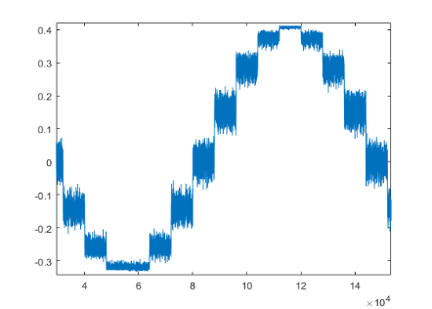
SFCW Code Flow Diagram

Slide 16
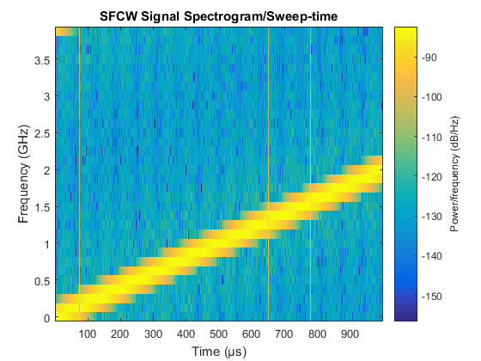
SFCW Output
Spectrum Plot
Sweep time
Frequency
Noise

Slide 17
SFCW Output
IFFT Plot
Circulator Coupling
Return Power
Noise floor
Object Distance

Slide 18
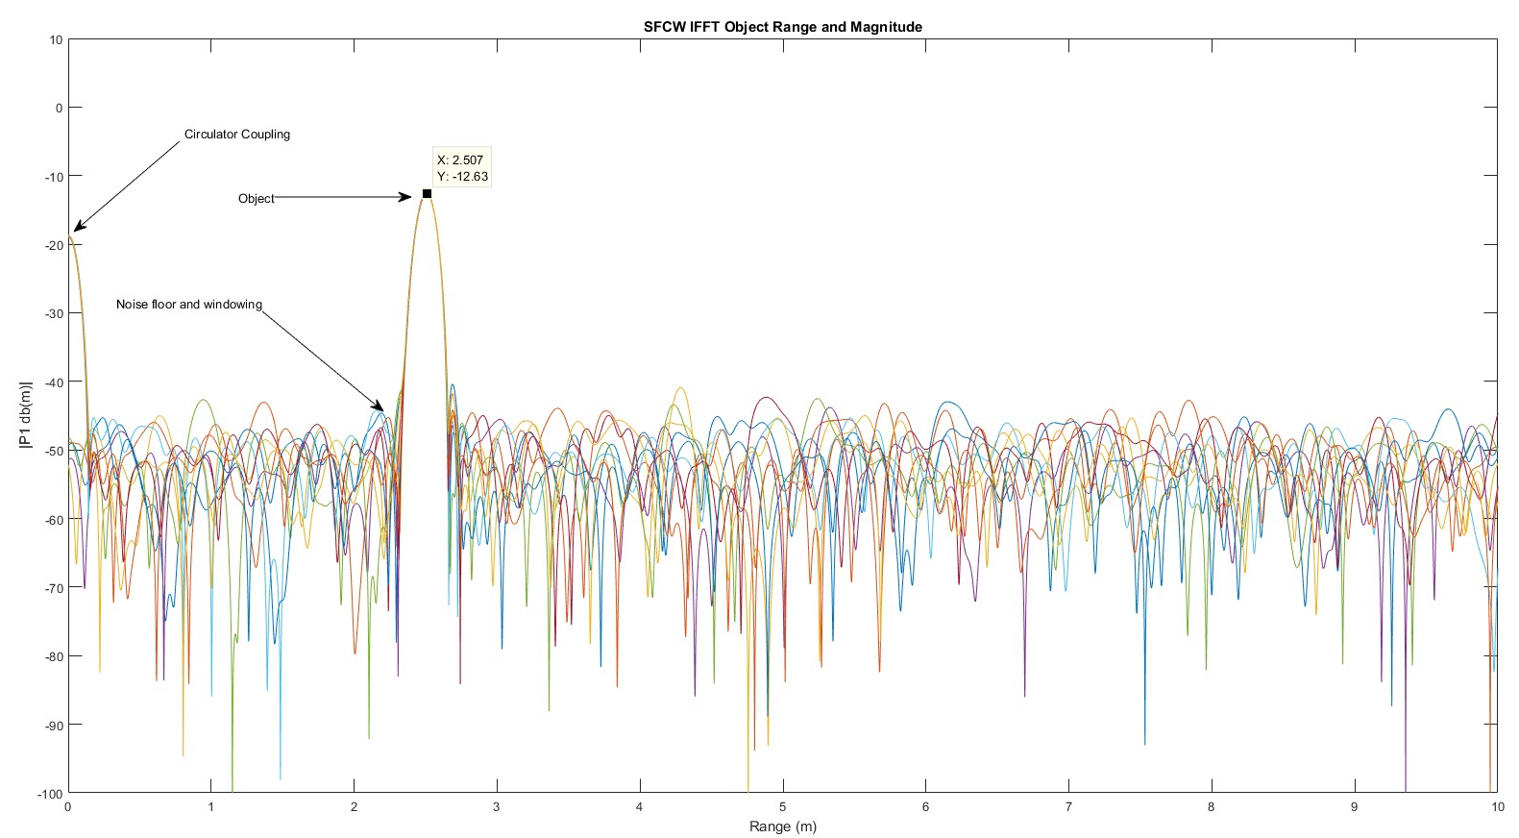
SFCW Output

Slide 19
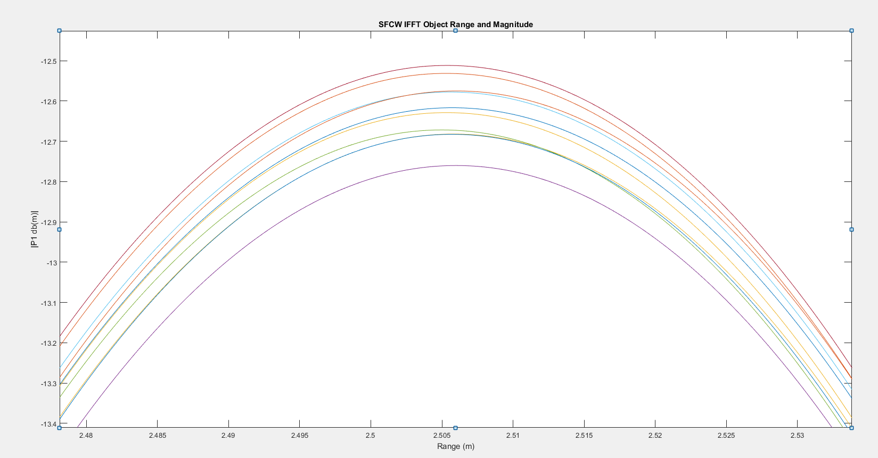
SFCW Output

Slide 20
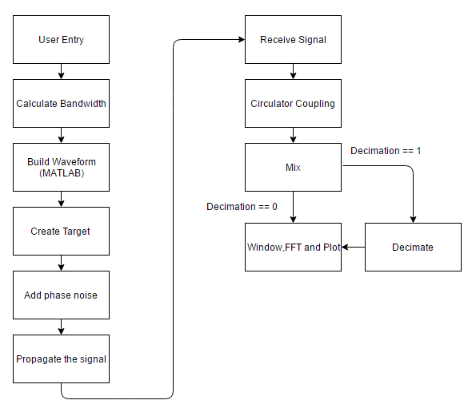
FMCW Code Flow Diagram

Slide 21
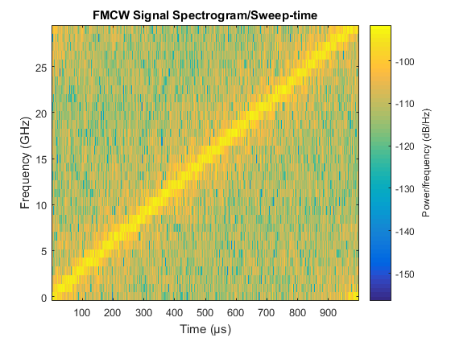
FMCW Output
Spectrum Plot
Sweep time
Frequency
Noise

Slide 22
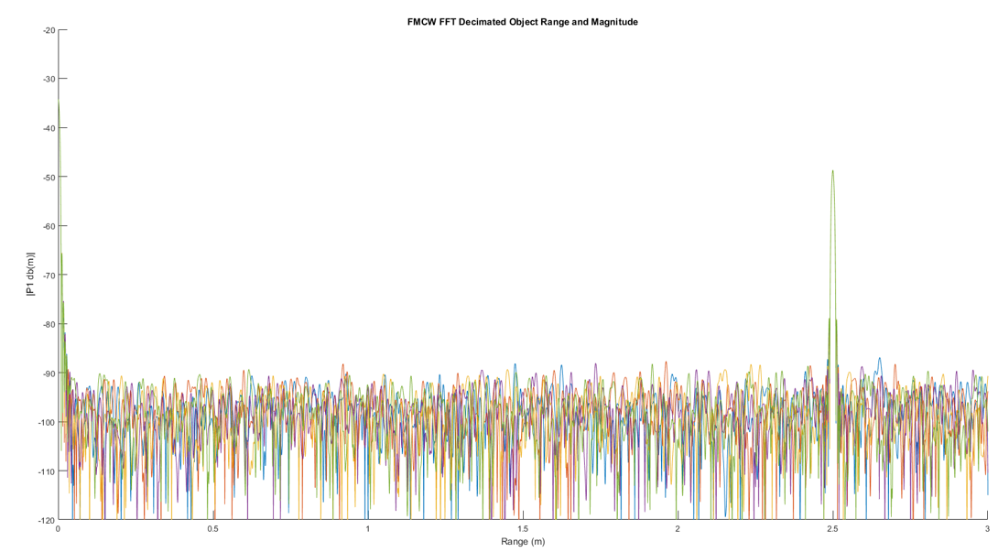
FMCW Decimated Output

Slide 23
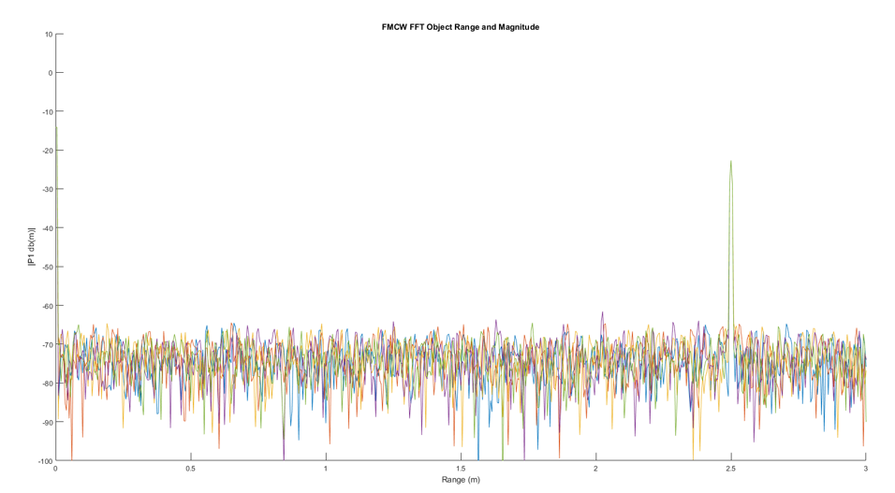
FMCW Output

Slide 24
NEXT STEPS

Slide 25
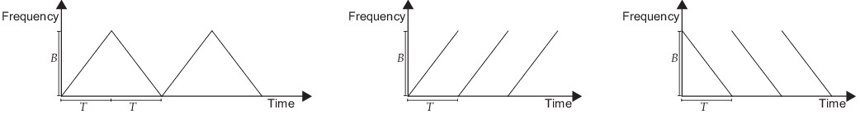
Accuracy & Testing
Extensive testing of all script files with different user inputs
Testing different dielectrics
Testing different types of sweeping in FMCW radar:
Triangle Sweep
Upsweep
Downsweep
Assuring the accuracy of the simulation stays in the desirable range

Slide 26
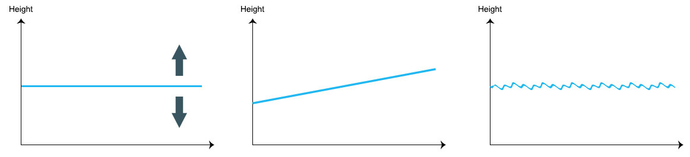
Sloshing
Sloshing model

Slide 27
Challenges
Overwhelming amount of research involved
Every new idea requires a lot of preliminary studies to be done before its implementation
Increasing level of detail of simulation increases overall complexity
Lack of time available
MATLAB issues
Unavoidable RAM overflow prevents from simulating several quantities with real-world values

Slide 28
Questions?

